Slide 1
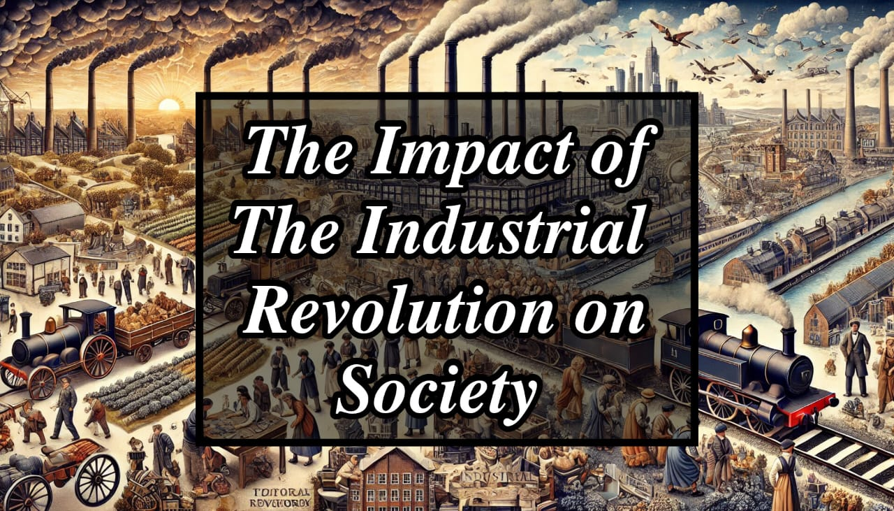

Slide 2
Introduction :
Definition : The Industrial Revolution was a period between the late 1700s and mid-1800s when major changes occurred in manufacturing, transportation, and society. It began in Britain and soon spread across Europe, the United States, and the rest of the world.
Main Idea: This period marked the shift from hand-made goods to machine-based production, leading to significant changes in economic, social, and cultural life.
Key Factors: It was driven by innovations such as the steam engine, the spinning jenny, and the power loom. These developments allowed factories to produce goods on a massive scale, transforming how people worked, lived, and interacted.

Slide 3
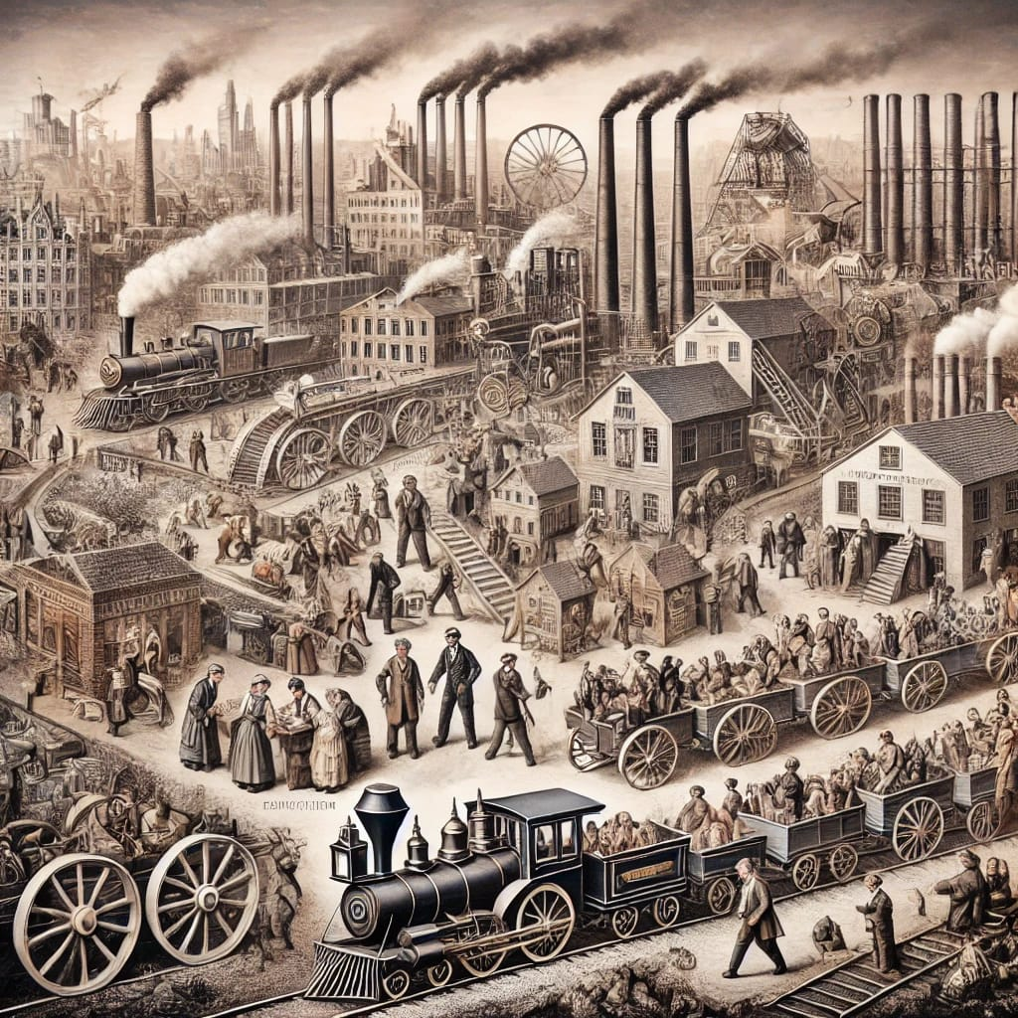

Slide 4
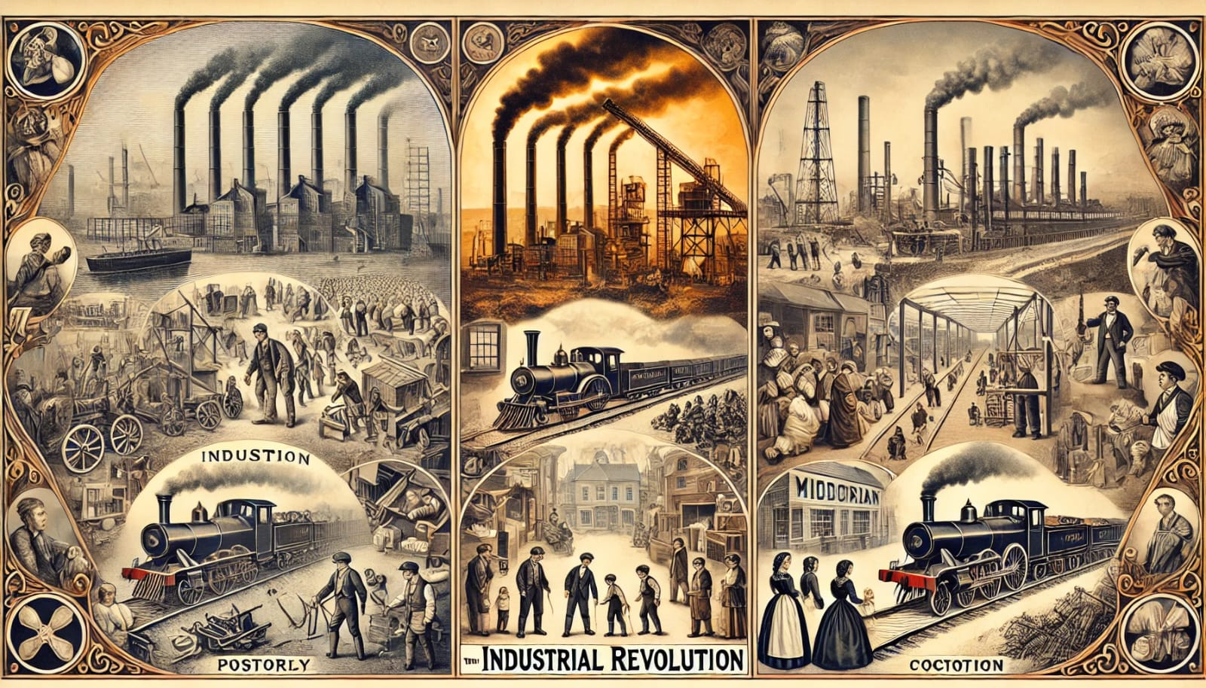

Slide 5
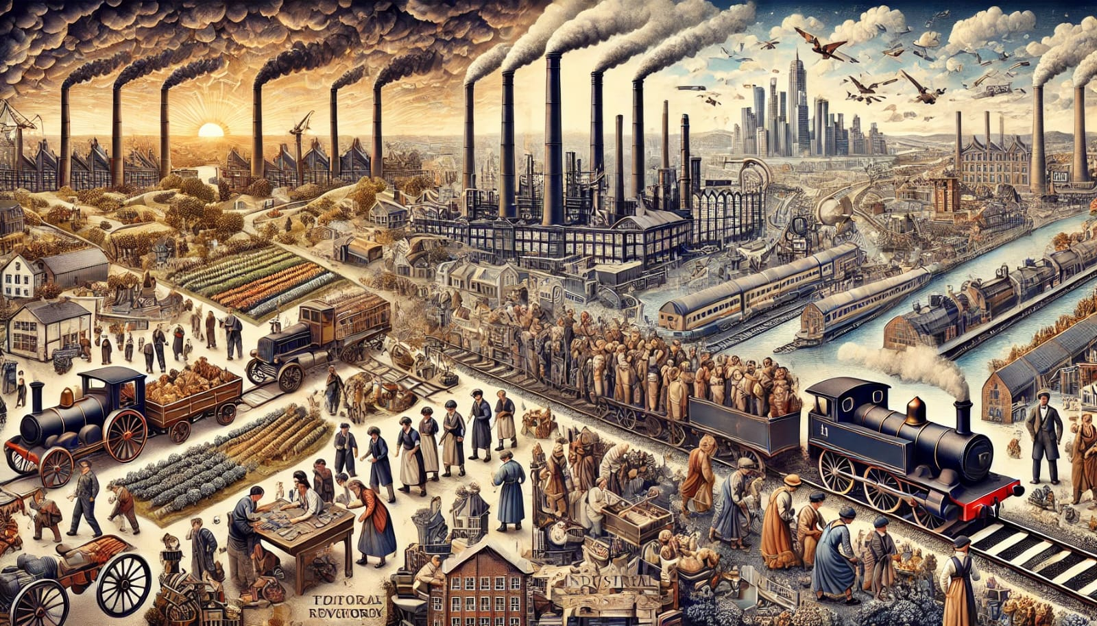

Slide 6


Slide 7
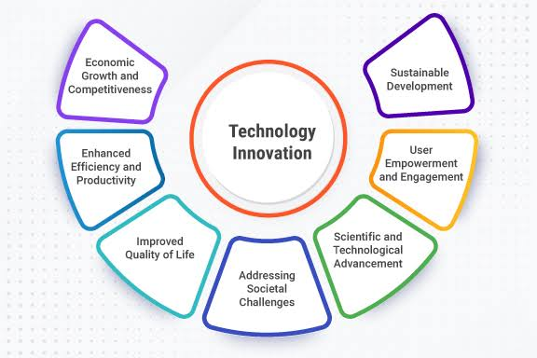

Slide 8
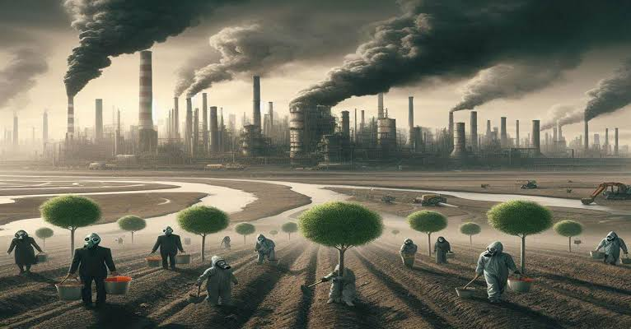

Slide 9
Conclusion
Key Points:
The Industrial Revolution was a transformative period in history that reshaped economies, societies, and cultures. It brought about significant technological advancements that laid the foundation for the modern world.
However, the benefits of industrialization were not evenly distributed. While factory owners and investors grew rich, many workers lived in poverty and suffered from poor working conditions. The environmental consequences of industrialization are still felt today, as pollution and resource depletion continue to be major global issues.
Legacy:
The Industrial Revolution’s impact is still visible in today’s world, influencing how we live, work, and interact with technology. It set the stage for the technological advancements of the 20th and 21st centuries and continues to shape global economies and societies.

